Slide 1
Git hub

Slide 2
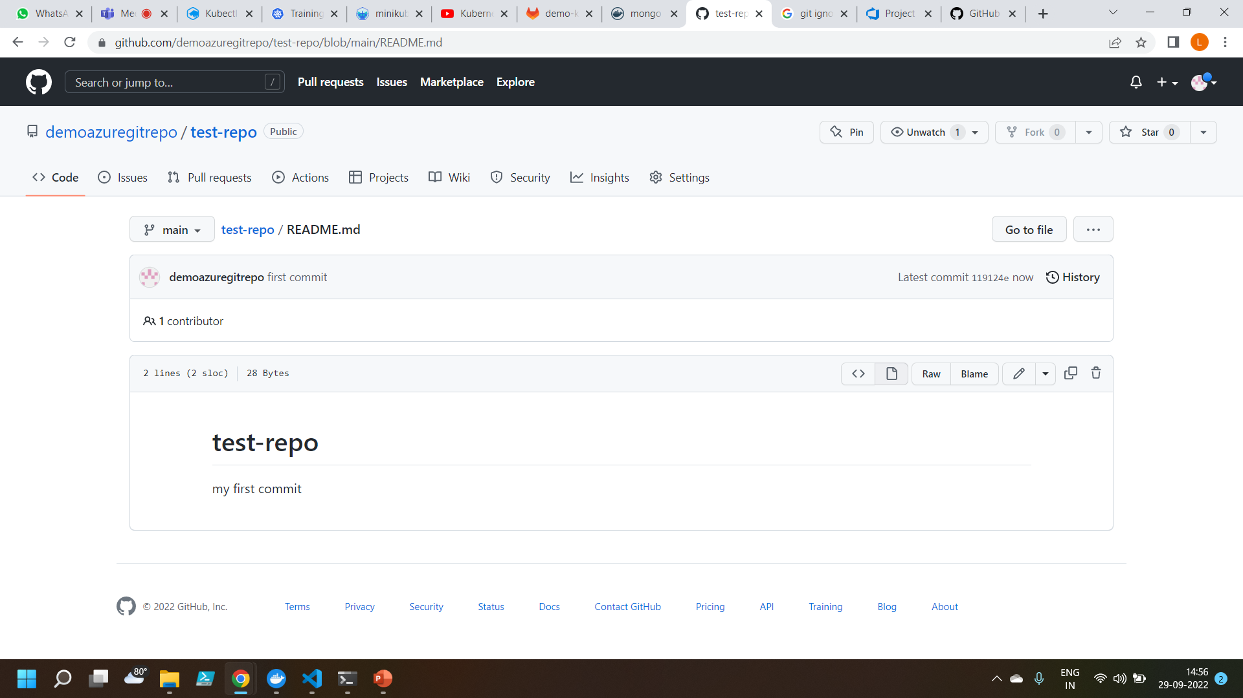
Commiting a change to the main branch

Slide 3
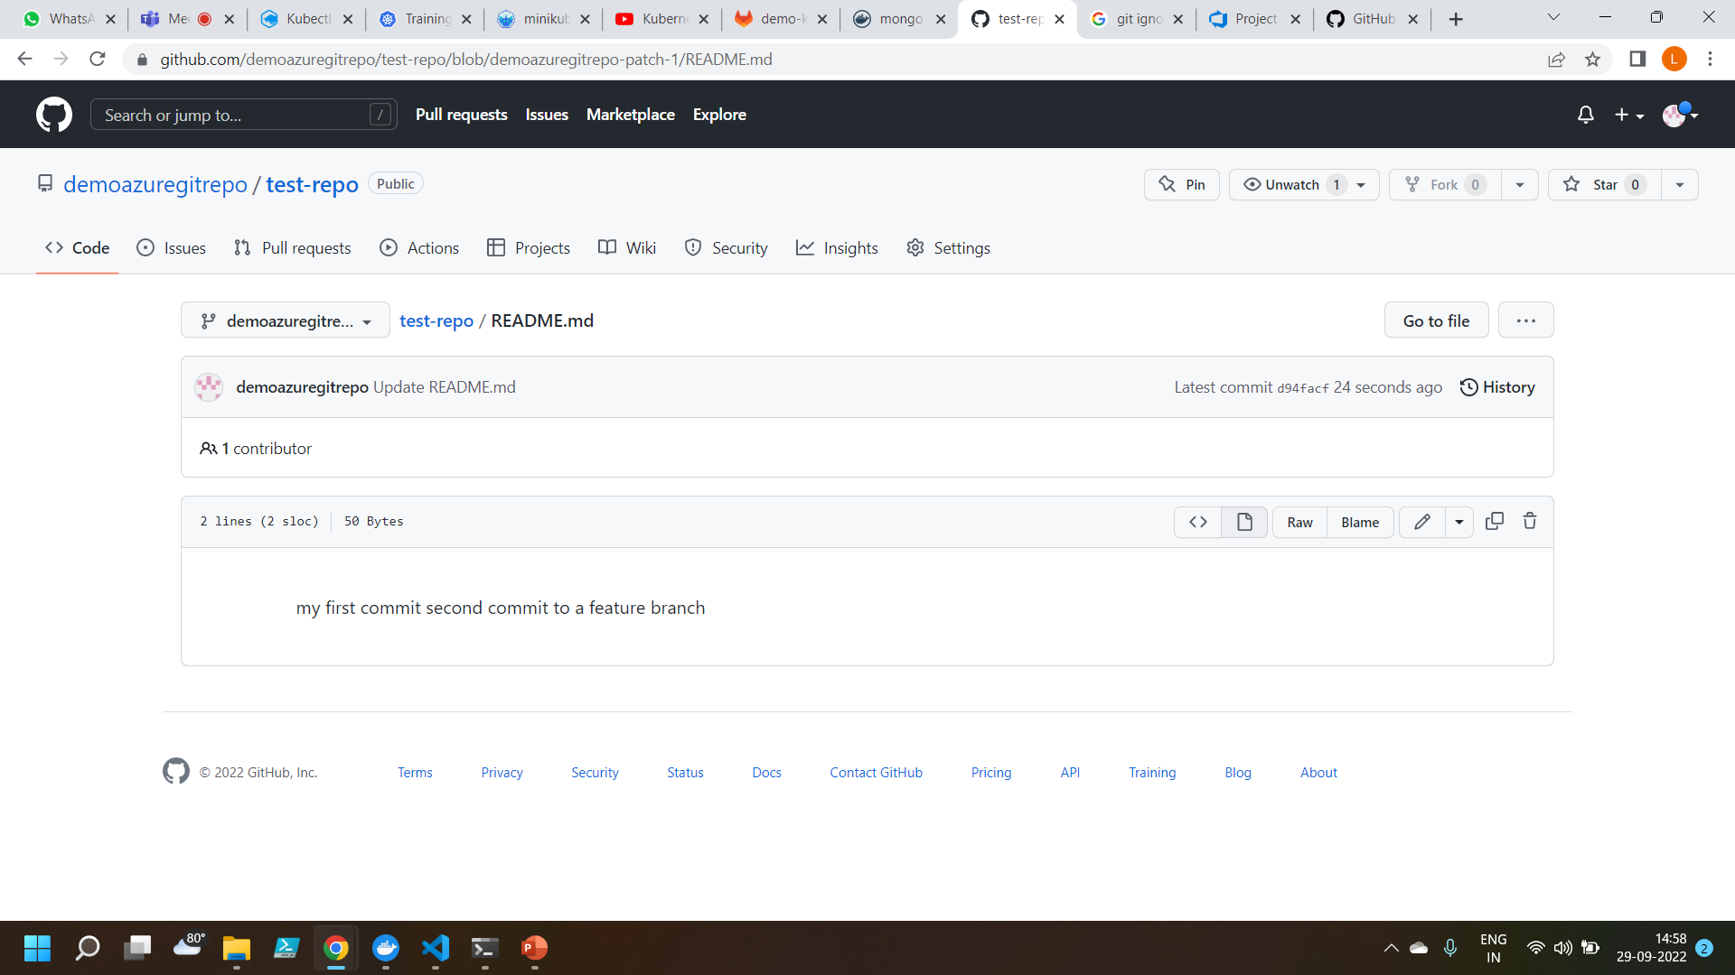
Commiting a change to the feature branch

Slide 4
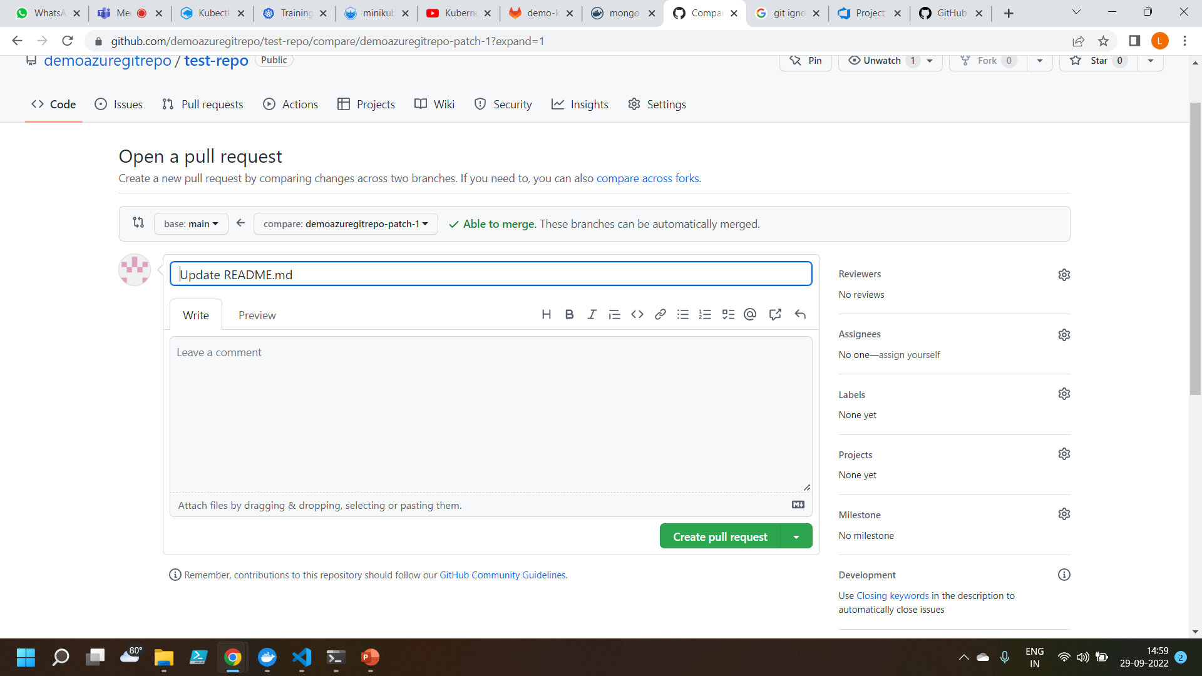
Created a pull request to merge the code into the main branch

Slide 5
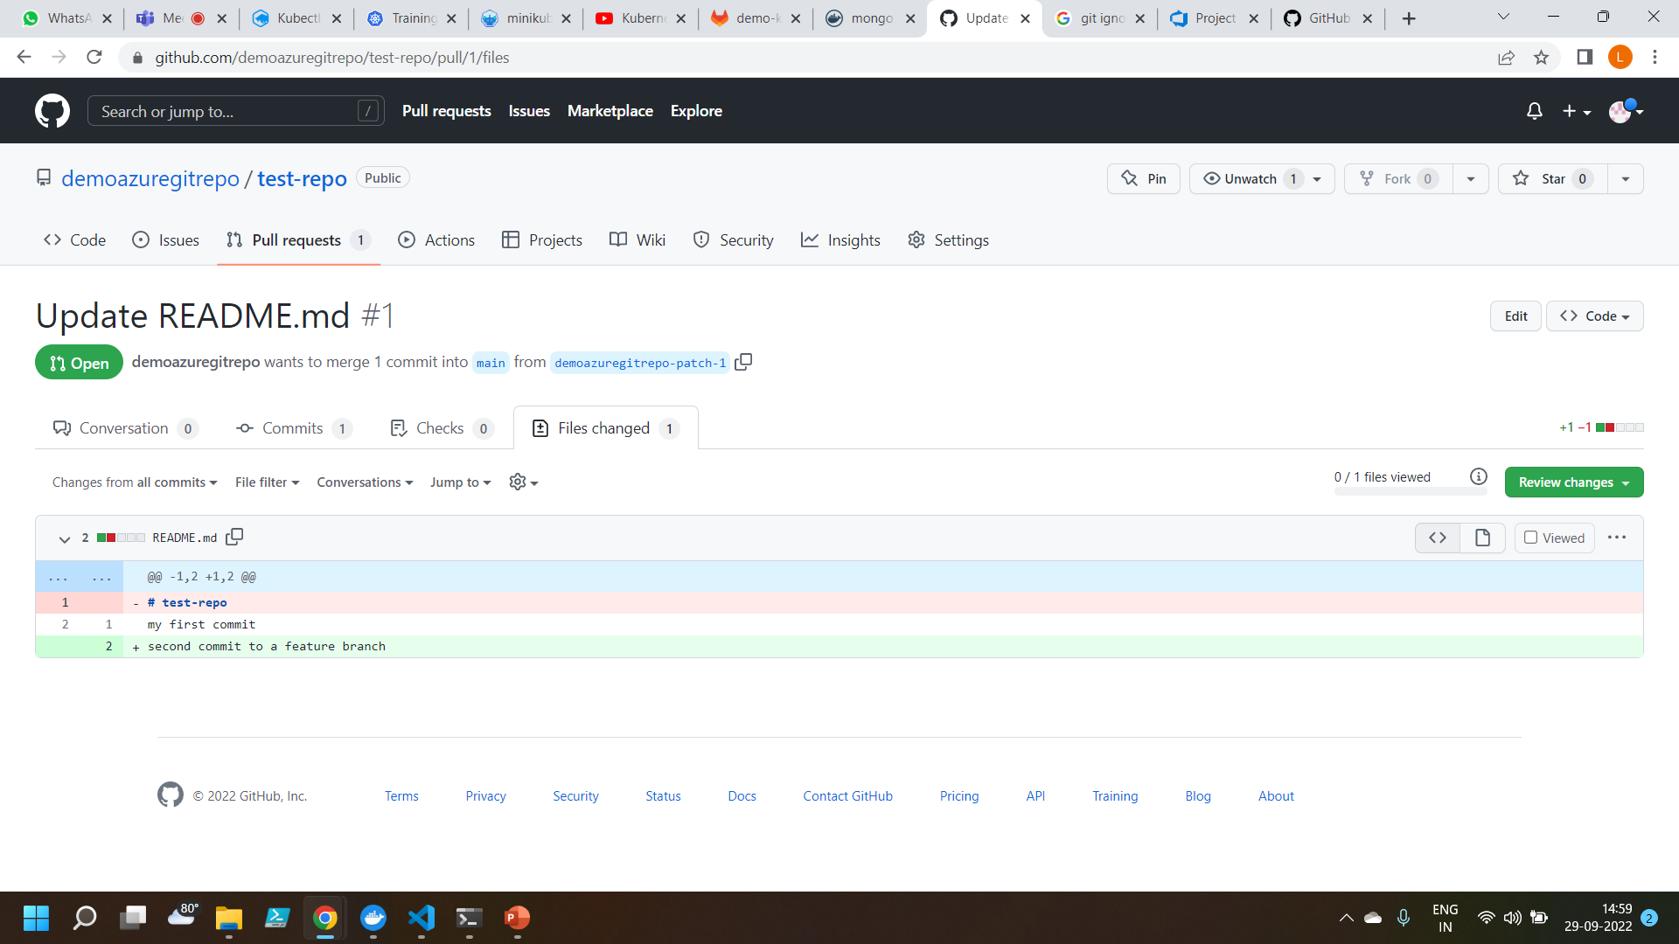
Changes are merged into the main branch

Slide 6
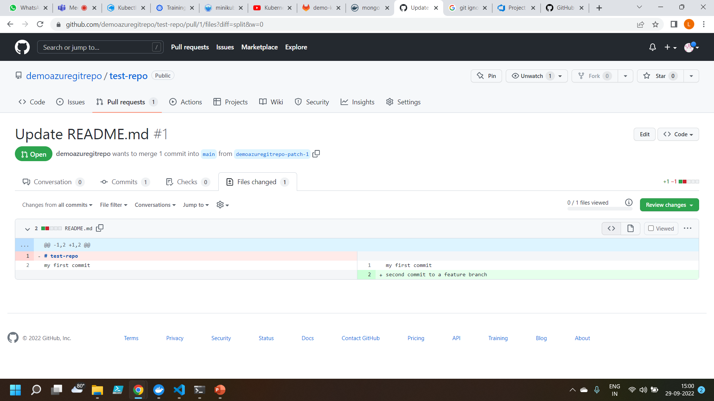
Performed insertion and deletion operations

Slide 7
Thankyou

